Slide 1
Information Extraction Lecture 9 – (Übung and) Event Extraction
CIS, LMU München
Winter Semester 2015-2016
Dr. Alexander Fraser, CIS

Slide 2
Administravia
Seminar:
Hausarbeit is due 3 weeks after your presentation
However, Xmas break (24th to 6th) does not count towards your three weeks
Add two more weeks if your working period touches these dates

Slide 3
Today we will start with a quick review of the Übung to make sure you have the key concepts
If you are one of the few people who are not in the Seminar
You will still be able to follow what I am discussing
You can try doing the Übung (Exercise2) by simply going to the Seminar web page and downloading the relevant materials

Slide 4
Review of Übung
In the Übung last week, we used the open source machine learning package Wapiti
We worked on a binary learning task: finding <stime> tags
We looked at:
Basic setup (compiling Wapiti, create sa-tagged directory) – "make prep"
How to run experiments (train, development, test) – "make"
Basic feature extraction code "extract_003.pl"
Wapiti pattern files "unigram_bigram_pattern.txt"

Slide 5
How to run experiments (train, development, test)
Ideally you should run shell scripts like this:
bash myscript.sh >& myscript.sh.log
This saves the output into a log file (I always do this, and none of my scripts take parameters)
Even better would be to have the extractor print version numbers (and maybe use source control)

Slide 6
Basic feature extraction code
We looked at extract_003.pl
This extracts a raw representation which I sometimes refer to as the "features", but which should really be referred to differently
Let's call what this outputs the extract file
The extract file is used to build the actual features used by Wapiti (and contains the gold-standard labels for training data or test data where we want Wapiti to calculate precision/recall and F)

Slide 7
Wapiti pattern files
Wapiti pattern files are a level of indirection that allow us to:
1) specify whether a column in the extract file is used
This is useful to "comment out" features in the extract file
Otherwise it is annoying – you have to remember to explicitly enable each new column as a feature
2) create features that combine columns (so-called "compound" features)
Two features put together is often called a bigram

Slide 8
Beyond binary classification
Wapiti supports multi-class classification
You can just change the label in the last column in the "extract" file to any string
Then retrain
Very abstractly, it is doing something like one-against-all as I explained in class
The details are more complicated, in fact it is a multi-class maximum entropy model
I will skip the details (at least for now)

Slide 9
Sequence classification
There is also a script that does sequence classification
When using sequence classification, you have several rows like in the extract file
But without blank lines between them
This is a sequence
You define a special feature which says "look at the previous label" (this feature starts with the letter "b" in the Wapiti pattern file, because it is defining a feature on the previous label and current label, which is a *label* bigram feature)
You'll notice that the extract is much simpler, because we can refer to the word in the previous example, or the word in the next example (instead of including these as columns as we did previously)
We will look at sequence classification in a further lab after the break

Slide 10
Conclusion
Wapiti is a very interesting package for multi-class and sequential multi-class classification
It is also quite easy to use
Except the annoying bug that we engineered around (where we added a single letter to very simple features like "isUpper" or "isNotUpper")
Read the manual to see what it can do
A further detail for avoiding overfitting the training corpus is a technique called "regularization"
See the Wapiti paper (cited on the website) for more about this

Slide 11
Event Extraction
We'll now discuss event extraction, as defined in state-of-the-art statistical systems

Slide 12
Outline
Event Definition
Event Knowledge Networks Construction
Basic Event Extraction Approach
Advanced Event Extraction Approaches
Information Redundancy for Inference
Co-training
Slide modified from Heng Ji

Slide 13
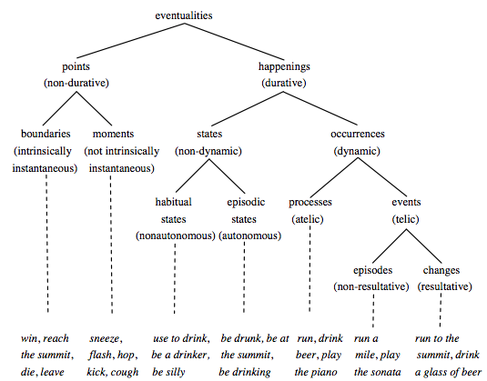
General Event Definition
An Event is a specific occurrence involving participants.
An Event is something that happens.
An Event can frequently be described as a change of state.
Most of current NLP work focused on this
Chart from (Dölling, 2011)
Slide from Heng Ji
13
Notes:
Make this more pretty, put pictures; revise the next picture to reflect these steps
13

Slide 14
Event Extraction
Task Definition
Basic Event Extraction Approach
Advanced Event Extraction Approaches
Information Redundancy for Inference
Co-training
Slide modified from Heng Ji

Slide 15
Event Mention Extraction: Task
An event is specific occurrence that implies a change of states
event trigger: the main word which most clearly expresses an event occurrence
event arguments: the mentions that are involved in an event (participants)
event mention: a phrase or sentence within which an event is described, including trigger and arguments
Automatic Content Extraction defined 8 types of events, with 33 subtypes
ACE event type/subtype Event Mention Example
Life/Die Kurt Schork died in Sierra Leone yesterday
^
Transaction/Transfer GM sold the company in Nov 1998 to LLC
Movement/Transport Homeless people have been moved to schools
Business/Start-Org Schweitzer founded a hospital in 1913
Conflict/Attack the attack on Gaza killed 13
Contact/Meet Arafat’s cabinet met for 4 hours
Personnel/Start-Position She later recruited the nursing student
Justice/Arrest Faison was wrongly arrested on suspicion of murder
Argument, role=victim
trigger
Slide from Heng Ji

Slide 16
Supervised Event Mention Extraction: Methods
Staged classifiers
Trigger Classifier
to distinguish event instances from non-events, to classify event instances by type
Argument Classifier
to distinguish arguments from non-arguments
Role Classifier
to classify arguments by argument role
Reportable-Event Classifier
to determine whether there is a reportable event instance
Can choose any supervised learning methods such as MaxEnt and SVMs
(Ji and Grishman, 2008)
Slide from Heng Ji

Slide 17
Typical Event Mention Extraction Features
Trigger Labeling
Lexical
Tokens and POS tags of candidate trigger and context words
Dictionaries
Trigger list, synonym gazetteers
Syntactic
the depth of the trigger in the parse tree
the path from the node of the trigger to the root in the parse tree
the phrase structure expanded by the parent node of the trigger
the phrase type of the trigger
Entity
the entity type of the syntactically nearest entity to the trigger in the parse tree
the entity type of the physically nearest entity to the trigger in the sentence
Argument Labeling
Event type and trigger
Trigger tokens
Event type and subtype
Entity
Entity type and subtype
Head word of the entity mention
Context
Context words of the argument candidate
Syntactic
the phrase structure expanding the parent of the trigger
the relative position of the entity regarding to the trigger (before or after)
the minimal path from the entity to the trigger
the shortest length from the entity to the trigger in the parse tree
(Chen and Ji, 2009)
Slide from Heng Ji
Notes:
IE’s application

Slide 18
Why Trigger Labeling is so Hard?
DT this “this is the largest pro-troops demonstration that has ever been in San Francisco”
RP forward “We've had an absolutely terrific story, pushing forward north toward Baghdad”
WP what “what happened in”
RB back “his men back to their compound”
IN over “his tenure at the United Nations is over”
IN out “the state department is ordering all non-essential diplomats”
CD nine eleven “nine eleven”
RB formerly “McCarthy was formerly a top civil servant at”
Slide from Heng Ji
Notes:
IE’s application

Slide 19
Why Trigger Labeling is so Hard?
A suicide bomber detonated explosives at the entrance to a crowded
medical teams carting away dozens of wounded victims
dozens of Israeli tanks advanced into thenorthern Gaza Strip
Many nouns such as “death”, “deaths”, “blast”, “injuries” are missing
Slide from Heng Ji
Notes:
IE’s application

Slide 20
Why Argument Labeling is so Hard?
Two 13-year-old children were among those killed in the Haifa bus bombing, Israeli public radio said, adding that most of the victims were youngsters
Israeli forces staged a bloody raid into a refugee camp in central Gaza targeting a founding member of Hamas
Israel's night-time raid in Gaza involving around 40 tanks and armoured vehicles
Eight people, including a pregnant woman and a 13-year-old child were killed in Monday's Gaza raid
At least 19 people were killed and 114 people were wounded in Tuesday's southern Philippines airport
Slide modified from Heng Ji
Notes:
IE’s application

Slide 21
Why Argument Labeling is so Hard?
Two 13-year-old children were among those killed in the Haifa bus bombing, Israeli public radio said, adding that most of the victims were youngsters
Fifteen people were killed and more than 30 wounded Wednesday as a suicide bomber blew himself up on a student bus in the northern town of Haifa
Two 13-year-old children were among those killed in the Haifa bus bombing
Slide from Heng Ji
Notes:
IE’s application

Slide 22
State-of-the-art and Remaining Challenges
State-of-the-art Performance (F-score)
English: Trigger 70%, Argument 45%
Chinese: Trigger 68%, Argument 52%
Single human annotator: Trigger 72%, Argument 62%
Remaining Challenges
Trigger Identification
Generic verbs
Support verbs such as “take” and “get” which can only represent an event mention together with other verbs or nouns
Nouns and adjectives based triggers
Trigger Classification
“named” represents a “Personnel_Nominate” or “Personnel_Start-Position”?
“hacked to death” represents a “Life_Die” or “Conflict_Attack”?
Argument Identification
Capture long contexts
Argument Classification
Capture long contexts
Temporal roles
(Ji, 2009; Li et al., 2011)
Slide from Heng Ji
Notes:
IE’s application

Slide 23
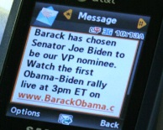
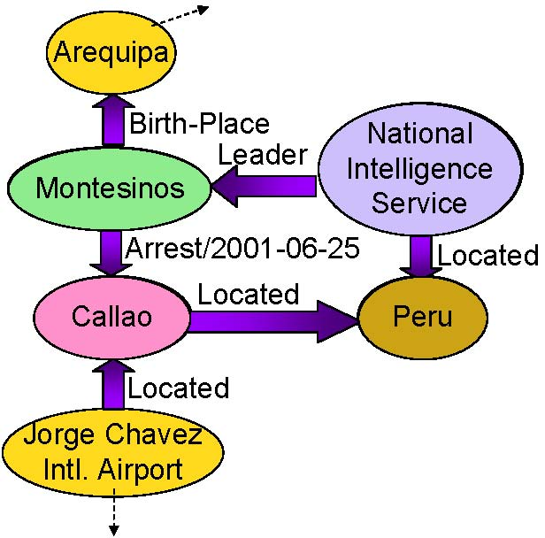
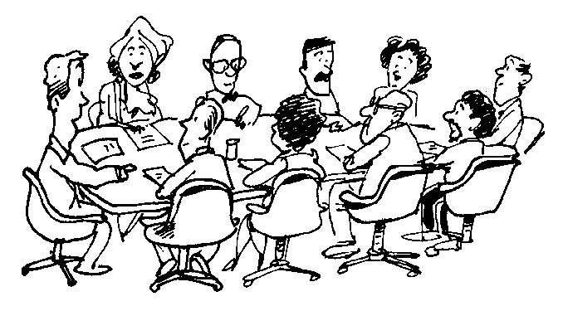
IE in Rich Contexts
Time/Location/
Cost Constraints
Texts
Authors
Venues
IE
Information Networks
Human Collaborative Learning
Slide from Heng Ji
Notes:
₂₃

Slide 24
Capture Information Redundancy
When the data grows beyond some certain size, IE task is naturally embedded in rich contexts; the extracted facts become inter-dependent
Leverage Information Redundancy from:
Large Scale Data (Chen and Ji, 2011)
Background Knowledge (Chan and Roth, 2010; Rahman and Ng, 2011)
Inter-connected facts (Li and Ji, 2011; Li et al., 2011; e.g. Roth and Yih, 2004; Gupta and Ji, 2009; Liao and Grishman, 2010; Hong et al., 2011)
Diverse Documents (Downey et al., 2005; Yangarber, 2006; Patwardhan and Riloff, 2009; Mann, 2007; Ji and Grishman, 2008)
Diverse Systems (Tamang and Ji, 2011)
Diverse Languages (Snover et al., 2011)
Diverse Data Modalities (text, image, speech, video…)
But how? Such knowledge might be overwhelming…
Slide from Heng Ji
Notes:
However, if we take one step back by looking at human learning, we often see that students study in groups of two or more, mutually searching for the best understanding, solution or meaning; researchers gather together as a ``committee" or ``panel" to select the best paper/project proposal. Such activities are formalized as ``collaborative
. Events no longer exist on their own; they are connected to other topically-related documents, associated with authors (e.g., posters for blogs, reporters for news, speakers for conversation transcripts, authors for papers) and the publication venues (e.g., forums for blogs, agencies for news, conferences for papers), and linked to the geographical places where the documents are published. We call such heterogeneous contexts as the background ``information networks" for each candidate event in a test document, as depicted in Figure~\ref{overallframework}. However, it is not trivial to encode such contextual clues directly into the event extraction system because they are ubiquitously interrelated in various network structures.
learning"~\cite{Smith1992}.
In this paper we propose to directly incorporate multi-dimensional heterogeneous background information networks, through a new and uniformed biased propagation based topic modeling framework as described in our recent work~\cite{Deng2011}.
The underlying intuition is that multi-typed contextual information should be integrated but treated differently in the topic model. This method is designed to imitate human collaborative learning to seek topically-related events as ``collaborators" and enhance both training (portability) and testing (quality) an event extractor:
\begin{itemize}
\item \emph{training}: automatically select topically-related documents as for training data annotation; we shall demonstrate that this method can significantly reduce annotation cost.
%in this way using only 1/4 training data we can achieve comparable performance as passive learning;
%\vspace{-0.3cm}
\item \emph{testing}: conduct statistical cross-document inference within each topic cluster to favor consistency of interpretation across documents and achieve higher extraction quality; we shall demonstrate topic modeling provides a more effective way than information retrieval (IR)-based document clustering.
\end{itemize}

Slide 25
Cross-Sent/Cross-Doc Event Inference Architecture
Test
Doc
Within-Sent
Event
Tagger
UMASS
INDRI
IR
Cluster of Related
Docs
Within-Sent
Event
Tagger
Cross-Sent
Inference
Cross-Sent
Inference
Candidate
Events &
Confidence
Cross-Doc
Inference
Related
Events &
Confidence
Refined
Events
Slide from Heng Ji

Slide 26
Baseline Within-Sentence Event Extraction
Pattern matching
Build a pattern from each ACE training example of an event
British and US forces reported gains in the advance on Baghdad
→ PER report gain in advance on LOC
MaxEnt models
Trigger Classifier
to distinguish event instances from non-events, to classify event instances by type
Argument Classifier
to distinguish arguments from non-arguments
Role Classifier
to classify arguments by argument role
Reportable-Event Classifier
to determine whether there is a reportable event instance
Slide from Heng Ji

Slide 27
Global Confidence Estimation
Within-Sentence IE system produces local confidence
IR engine returns a cluster of related docs for each test doc
Document-wide and Cluster-wide Confidence
Frequency weighted by local confidence
XDoc-Trigger-Freq(trigger, etype): The weighted frequency of string trigger appearing as the trigger of an event of type etype across all related documents
XDoc-Arg-Freq(arg, etype): The weighted frequency of arg appearing as an argument of an event of type etype across all related documents
XDoc-Role-Freq(arg, etype, role): The weighted frequency of arg appearing as an argument of an event of type etype with role role across all related documents
Margin between the most frequent value and the second most frequent value, applied to resolve classification ambiguities
……
Slide from Heng Ji
Notes:
Uncertainty; delay the confidence estimation from the baseline,try to confirm or correct the results using global confidence; some examples are as follows.

Slide 28
Cross-Sent/Cross-Doc Event Inference Procedure
Remove triggers and argument annotations with local or cross-doc confidence lower than thresholds
Local-Remove: Remove annotations with low local confidence
XDoc-Remove: Remove annotations with low cross-doc confidence
Adjust trigger and argument identification and classification to achieve document-wide and cluster-wide consistency
XSent-Iden/XDoc-Iden: If the highest frequency is larger than a threshold, propagate the most frequent type to all unlabeled candidates with the same strings
XSent-Class/XDoc-Class: If the margin value is higher than a threshold, propagate the most frequent type and role to replace
low-confidence annotations
Slide from Heng Ji
Notes:
Two main operations…;

Slide 29
Experiments: Data and Setting
Within-Sentence baseline IE trained from 500 English ACE05 texts (from March – May of 2003)
Use 10 ACE05 newswire texts as development set to optimize the global confidence thresholds and apply them for blind test
Blind test on 40 ACE05 texts, for each test text, retrieved 25 related texts from TDT5 corpus (278,108 texts, from April-Sept. of 2003)
Slide from Heng Ji

Slide 30
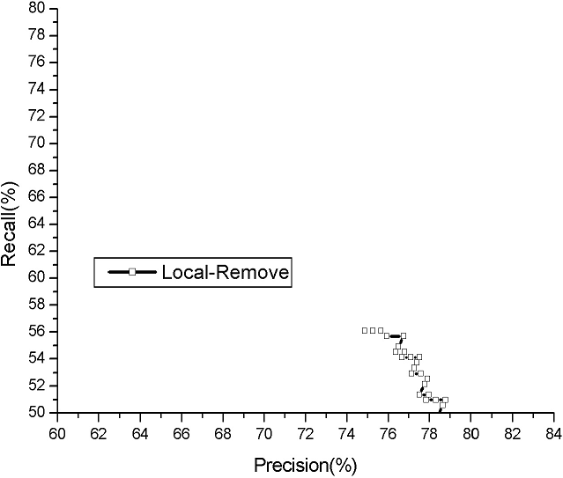
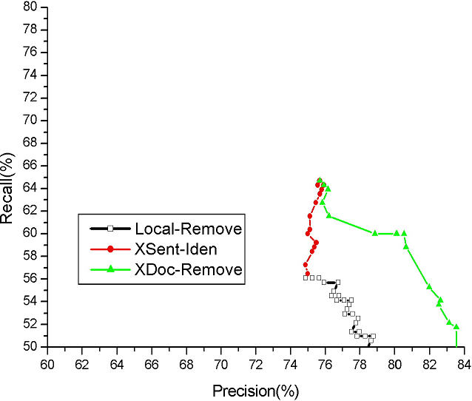
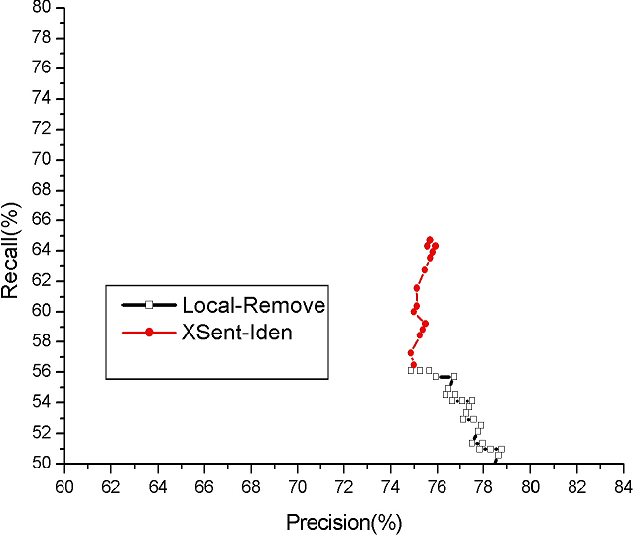
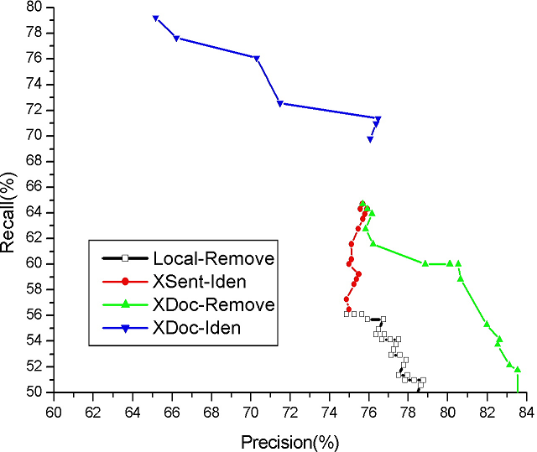
Selecting Trigger Confidence Thresholds to optimize Event Identification F-measure on Dev Set
73.8%
69.8%
69.8%
Best F=64.5%
Slide from Heng Ji

Slide 31
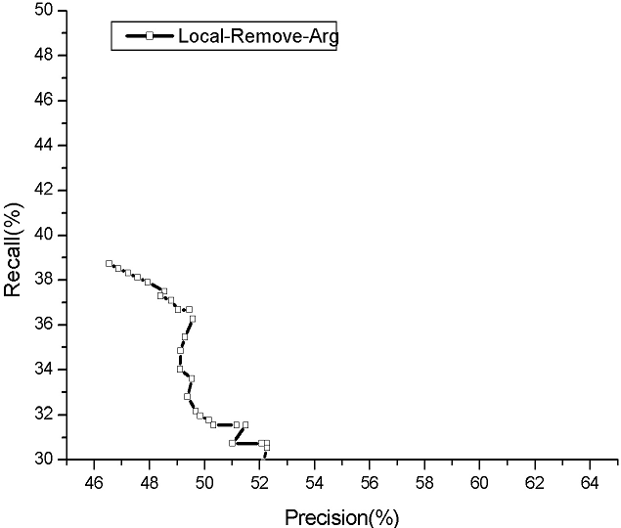
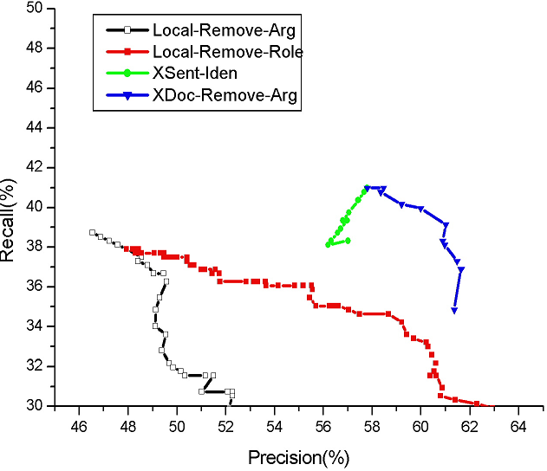
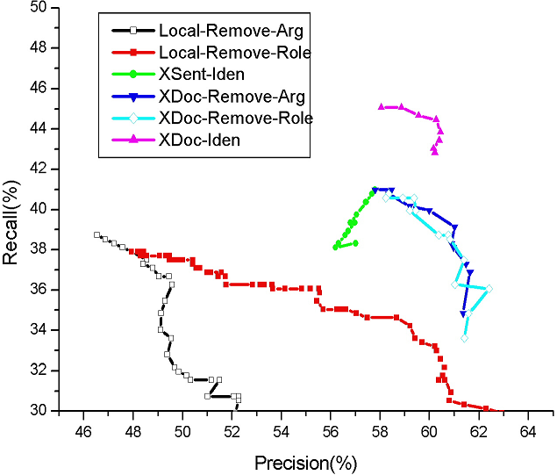
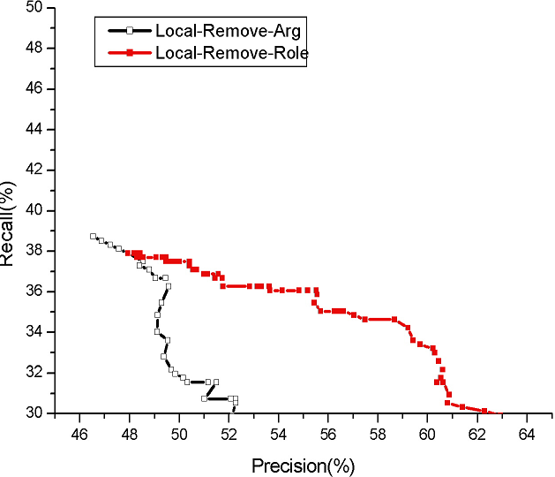
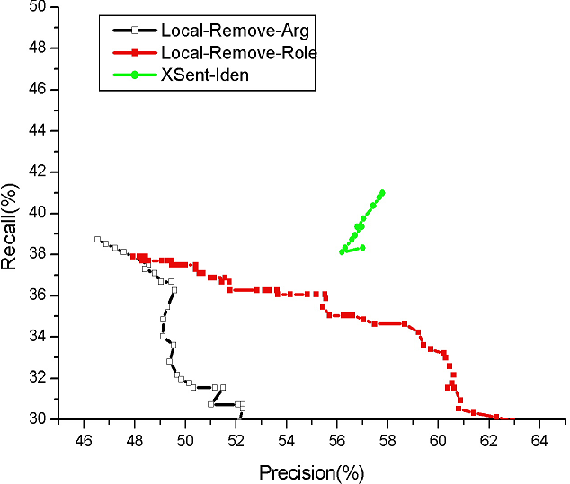
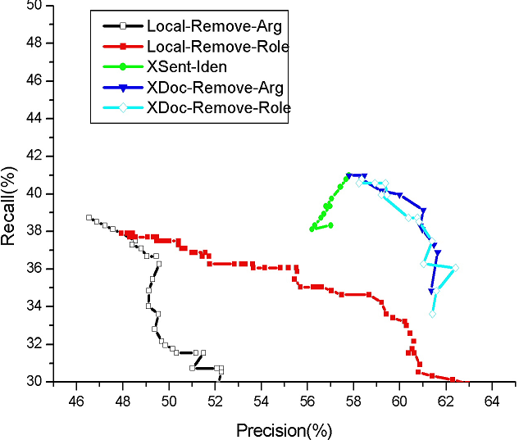
Selecting Argument Confidence Thresholds to optimize Argument Labeling F-measure on Dev Set
51.2%
48.0%
48.2%
48.3%
F=42.3%
43.7%
Slide from Heng Ji

Slide 32
Experiments: Trigger Labeling
Performance System/Human | Precision | Recall | F-Measure
Within-Sent IE (Baseline) | 67.6 | 53.5 | 59.7
After Cross-Sent Inference | 64.3 | 59.4 | 61.8
After Cross-Doc Inference | 60.2 | 76.4 | 67.3
Human Annotator 1 | 59.2 | 59.4 | 59.3
Human Annotator 2 | 69.2 | 75.0 | 72.0
Inter-Adjudicator Agreement | 83.2 | 74.8 | 78.8
Slide from Heng Ji
Notes:
In order to show how reliable of the key is, we try to count the inter-agreement of two keys prepared in parallel, and the agreement f-measure is about 78.8

Slide 33
Experiments: Argument Labeling
Performance System/Human | Argument Identification |  |  | Argument Classification Accuracy | Argument Identification +Classification
 | P | R | F |  | P | R | F
Within-Sent IE | 47.8 | 38.3 | 42.5 | 86.0 | 41.2 | 32.9 | 36.3
After Cross-Sent Inference | 54.6 | 38.5 | 45.1 | 90.2 | 49.2 | 34.7 | 40.7
After Cross-Doc Inference | 55.7 | 39.5 | 46.2 | 92.1 | 51.3 | 36.4 | 42.6
Human Annotator 1 | 60.0 | 69.4 | 64.4 | 85.8 | 51.6 | 59.5 | 55.3
Human Annotator 2 | 62.7 | 85.4 | 72.3 | 86.3 | 54.1 | 73.7 | 62.4
Inter-Adjudicator Agreement | 72.2 | 71.4 | 71.8 | 91.8 | 66.3 | 65.6 | 65.9
Slide from Heng Ji
Notes:
Our approach works much better than the baseline; for both identification and classification accuracy. There is a larger gap between system and human for argment labeling; argument identification is not a reasonable annotation. US news announced the news of invation into Iraq. Human has to remember everything said in the document.; maybe need arbitrary inference.

Slide 34
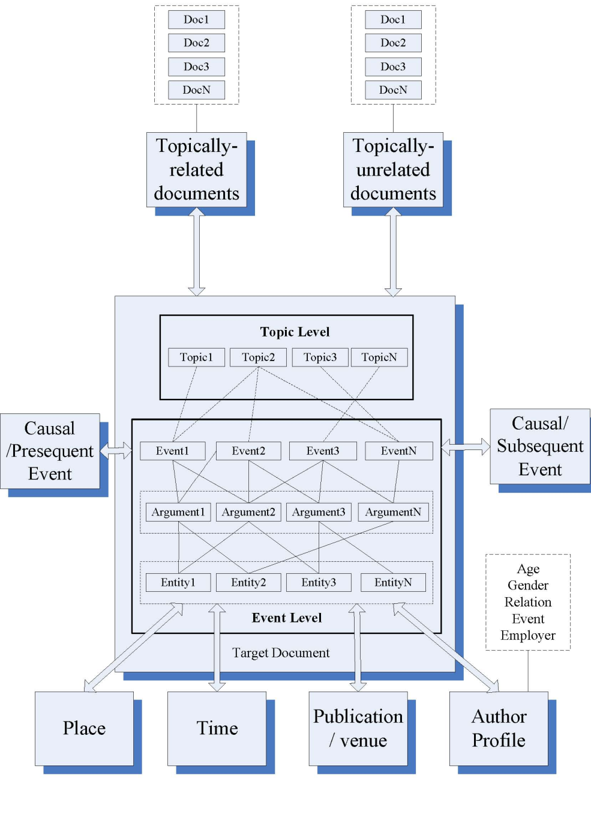
Global Knowledge based Inference for Event Extraction
Cross-document inference (Ji and Grishman, 2008)
Cross-event inference (Liao and Grishman, 2010)
Cross-entity inference (Hong et al., 2011)
All-together (Li et al., 2011)
Slide from Heng Ji

Slide 35
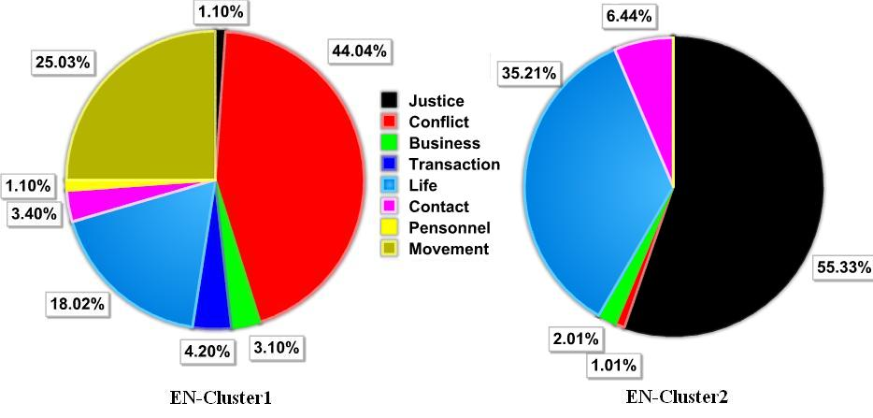
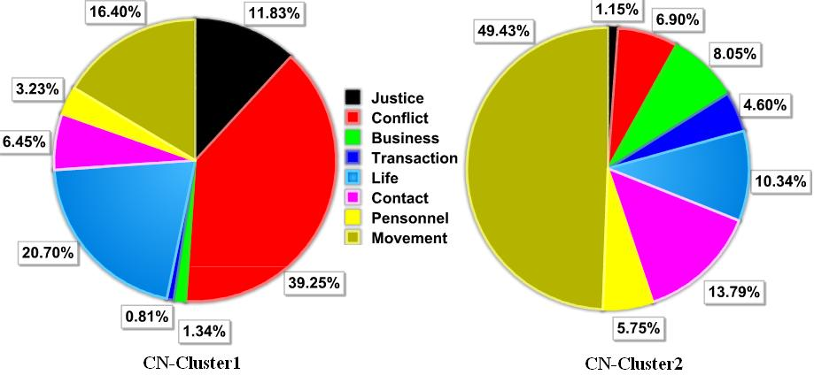
Leveraging Redundancy with Topic Modeling
Within a cluster of topically-related documents, the distribution is much more convergent; closer to its distribution in the collection of topically related documents than the uniform training corpora
e.g. In the overall information networks only 7% of “fire” indicate “End-Position” events; while all of “fire” in a topic cluster are “End-Position” events
e.g. “Putin” appeared as different roles, including “meeting/entity”, “movement/person”, “transaction/recipient” and “election/person”, but only played as an “election/person” in one topic cluster
Topic Modeling can enhance information network construction by grouping similar objects, event types and roles together
Slide from Heng Ji
Notes:
35

Slide 36
Bootstrapping Event Extraction
Both systems rely on expensive human labeled data, thus suffers from data scarcity
(much more expensive than other NLP tasks due to the extra tagging tasks of entities and temporal expressions)
Questions:
Can the monolingual system benefit from bootstrapping techniques with a relative small set of training data?
Can a monolingual system (in our case, the Chinese event extraction system) benefit from the other resource-rich monolingual system (English system)?
Slide from Heng Ji

Slide 37
Cross-lingual Co-Training
Intuition:
The same event has different “views” described in different languages, because the lexical unit, the grammar and sentence construction differ from one language to the other.
Satisfy the sufficiency assumption
Slide from Heng Ji

Slide 38
Cross-lingual Co-Training for Event Extraction
(Chen and Ji, 2009)
Labeled Samples
in Language A
Unlabeled
Bitexts
Labeled Samples
in Language B
train
Select at Random
train
System for
Language A
System for
Language B
B
Bilingual Pool with
constant size
Event Extraction
Event Extraction
A
High Confidence
Samples A
Cross-lingual
Projection
High Confidence
Samples B
Projected
Samples A
Projected
Samples B
Bootstrapping: n=1: trust yourself and teach yourself
Co-training: n=2 (Blum and Mitchell,1998)
the two views are individually sufficient for classification
the two views are conditionally independent given the class
Slide from Heng Ji
Notes:
May need to re-draw pool figure
38

Slide 39
Cross-lingual Projection
A key operation in the cross-lingual co-training algorithm
In our case, project the triggers and the arguments from one language into the other language according to the alignment information provided by bitexts.
Slide from Heng Ji
Notes:
To highlight alignments
39

Slide 40
Experiments (Chen and Ji, 2009)
Data
ACE 2005 corpus
560 English documents
633 Chinese documents
LDC Chinese Treebank English Parallel corpus
159 bitexts with manual alignment
Slide from Heng Ji

Slide 41
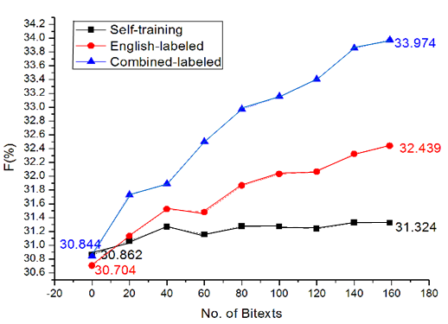
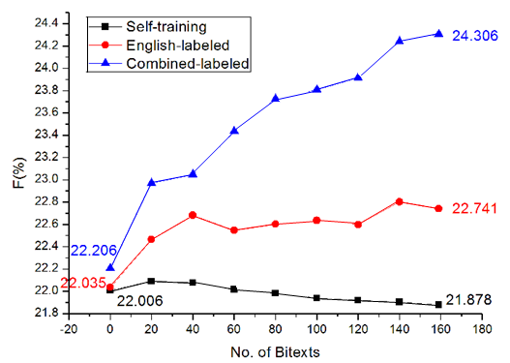
Experiment results
Self-training, and Co-training
(English- labeled & Combined-labeled)
for Trigger Labeling
Self-training, and Co-training
(English- labeled & Combined-labeled)
for Argument Labeling
Slide from Heng Ji

Slide 42
Analysis
Self-training: a little gain of 0.4% above the baseline for trigger labeling and a loss of 0.1% below the baseline for argument labeling. The deterioration tendency of the self-training curve indicates that entity extraction errors do have counteractive impacts on argument labeling.
Trust-English method: a gain of 1.7% for trigger labeling and 0.7% for argument labeling.
Combination method: a gain of 3.1% for trigger labeling and 2.1% for argument labeling.
The third method outperforms the second method.
Slide from Heng Ji

Slide 43
Slides
The slides for event extraction are from Heng Ji, who is a IE researcher at RPI

Slide 44
Summary
Event extraction is an interesting topic which has recently started to undergo significant changes
In these slides we talked about cross-document reference
One can go further and include the web and/or ontologies (next lecture)
It is a very difficult problem but clearly necessary if we want to reason about changes of state, rather than facts that hold over long periods of time

Slide 45
Thank you for your attention!

