Slide 1
Information Extraction
Lecture 4 – Named Entity Recognition II
CIS, LMU München
Winter Semester 2016-2017
Dr. Alexander Fraser, CIS

Slide 2
Administravia
Seminar
  Please check the web page to make sure I recorded your topic correctly!
  There is now a LaTeX template for the Hausarbeit on the Seminar web page

Slide 3
Reading
Please read Sarawagi Chapter 3 for next time
  Sarawagi talks about classifier based IE in Chapter 3
  Unfortunately, the discussion is very technical. I would recommend reading it, but not worrying too much about the math (yet), just get the basic idea
  You may find yourself wanting to reread Chapter 3 again after we discuss machine learning

Slide 4
Outline
Evaluation in more detail
  Look at Information Retrieval
Return to Rule-Based NER
  The CMU Seminar dataset
Issues in Evaluation of IE
Human Annotation for NER

Slide 5
Recall
Measure of how much relevant information the system has extracted (coverage of system).
Exact definition:
Recall = 1 if no possible correct answers
else:
# of correct answers given by system
total # of possible correct answers in text
Slide modified from Butt/Jurafsky/Martin

Slide 6
Precision
Measure of how much of the information the system returned is correct (accuracy).
Exact definition:
Precision = 1 if no answers given by system
else:
# of correct answers given by system
# of answers given by system
Slide modified from Butt/Jurafsky/Martin

Slide 7
Evaluation
Every system, algorithm or theory should be evaluated, i.e. its output should be compared to the gold standard (i.e. the ideal output). Suppose we try to find scientists…
Algorithm output:
O = {Einstein, Bohr, Planck, Clinton, Obama}
✓
✓
✓
✗
✗
Gold standard:
G = {Einstein, Bohr, Planck, Heisenberg}
✓
✓
✓
✗
Precision:
What proportion of the
output is correct?
| O ∧ G |
|O|
Recall:
What proportion of the
gold standard did we get?
| O ∧ G |
|G|
Slide modified from Suchanek

Slide 8
Evaluation
Why Evaluate?
What to Evaluate?
How to Evaluate?
Slide from Giles

Slide 9
Why Evaluate?
Determine if the system is useful
Make comparative assessments with other methods/systems
  Who’s the best?
Test and improve systems
Others: Marketing, …
Slide modified from Giles

Slide 10
What to Evaluate?
In Information Extraction, we try to match a pre-annotated gold standard
But the evaluation methodology is mostly taken from Information Retrieval
  So let's consider relevant documents to a search engine query for now
  We will return to IE evaluation later

Slide 11
Relevant vs. Retrieved Documents
Retrieved
Relevant
All docs available
Set approach
Slide from Giles

Slide 12
Contingency table of relevant and retrieved documents
relevant
Rel
NotRel
Ret_{Rel}
Ret_{NotRel}
Ret
Ret = Ret_{Rel} + Ret_{NotRel}
retrieved
NotRet_{Rel}
NotRet_{NotRel}
NotRet = NotRet_{Rel} + NotRet_{NotRel}
NotRet
Relevant = Ret_{Rel} + NotRet_{Rel}
Not Relevant = Ret_{NotRel} + NotRet_{NotRel}
Total # of documents available N = Ret_{Rel} + NotRet_{Rel} + Ret_{NotRel} + NotRet_{NotRel}
Precision: P= Ret_{Rel} / Retrieved
Recall: R = Ret_{Rel} / Relevant
P = [0,1]
R = [0,1]
Slide from Giles

Slide 13
Contingency table of classification of documents
Actual Condition
Present
Absent
tp
fp
type1
fp type 1 error
Positive
Test result
fn
type2
tn
Negative
fn type 2 error
present = tp + fn
positives = tp + fp
negatives = fn + tn
Total # of cases N = tp + fp + fn + tn
False positive rate α = fp/(negatives)
False negative rate β = fn/(positives)
Slide from Giles

Slide 14
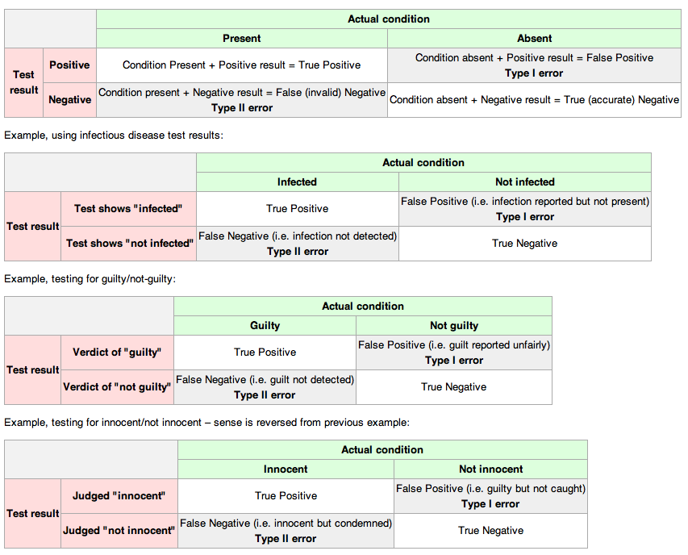
Slide from Giles

Slide 15
Retrieval example
Documents available: D1,D2,D3,D4,D5,D6,D7,D8,D9,D10
Relevant: D1, D4, D5, D8, D10
Query to search engine retrieves: D2, D4, D5, D6, D8, D9
 | relevant | not relevant
retrieved
not retrieved
Slide from Giles

Slide 16
Retrieval example
Documents available: D1,D2,D3,D4,D5,D6,D7,D8,D9,D10
Relevant: D1, D4, D5, D8, D10
Query to search engine retrieves: D2, D4, D5, D6, D8, D9
 | relevant | not relevant
retrieved | D4,D5,D8 | D2,D6,D9
not retrieved | D1,D10 | D3,D7
Slide from Giles

Slide 17
Precision and Recall – Contingency Table
Retrieved
Not retrieved
w=3
x=2
Relevant
Relevant = w+x= 5
y=3
z=2
Not relevant
Not Relevant = y+z = 5
Retrieved = w+y = 6
Not Retrieved = x+z = 4
Total documents N = w+x+y+z = 10
Precision: P= w / w+y =3/6 =.5
Recall: R = w / w+x = 3/5 =.6
Slide from Giles

Slide 18
Contingency table of relevant and retrieved documents
relevant
Rel
NotRel
Ret_{Rel}=3
Ret_{NotRel}=3
Ret
Ret = Ret_{Rel} + Ret_{NotRel}
= 3 + 3 = 6
retrieved
NotRet_{Rel}=2
NotRet_{NotRel}=2
NotRet
NotRet = NotRet_{Rel} + NotRet_{NotRe}
= 2 + 2 = 4
Relevant = Ret_{Rel} + NotRet_{Rel}
= 3 + 2 = 5
Not Relevant = Ret_{NotRel} + NotRet_{NotRel}
= 2 + 2 = 4
Total # of docs N = Ret_{Rel} + NotRet_{Rel} + Ret_{NotRel} + NotRet_{NotRel}= 10
Precision: P= Ret_{Rel} / Retrieved = 3/6 = .5
Recall: R = Ret_{Rel} / Relevant = 3/5 = .6
P = [0,1]
R = [0,1]
Slide from Giles

Slide 19
What do we want
Find everything relevant – high recall
Only retrieve what is relevant – high precision
Slide from Giles

Slide 20
Relevant vs. Retrieved
All docs
Retrieved
Relevant
Slide from Giles

Slide 21
Precision vs. Recall
All docs
Retrieved
Relevant
Slide from Giles

Slide 22
Retrieved vs. Relevant Documents
Very high precision, very low recall
retrieved
Relevant
Slide from Giles

Slide 23
Retrieved vs. Relevant Documents
High recall, but low precision
Relevant
retrieved
Slide from Giles

Slide 24
Retrieved vs. Relevant Documents
Very low precision, very low recall (0 for both)
retrieved
Relevant
Slide from Giles

Slide 25
Retrieved vs. Relevant Documents
High precision, high recall (at last!)
retrieved
Relevant
Slide from Giles

Slide 26
Why Precision and Recall?
Slide modified from Giles
Get as much of what we want while at the same time getting as little junk as possible.
Recall is the percentage of relevant documents returned compared to everything that is available!
Precision is the percentage of relevant documents compared to what is returned!
The desired trade-off between precision and recall is specific to the scenario we are in

Slide 27
Relation to Contingency Table
 | Doc is Relevant | Doc is NOT relevant
Doc is retrieved | a | b
Doc is NOT retrieved | c | d
Accuracy: (a+d) / (a+b+c+d)
Precision: a/(a+b)
Recall: a/(a+c)
Why don’t we use Accuracy for IR?
  (Assuming a large collection)
    Most docs aren’t relevant
    Most docs aren’t retrieved
    Inflates the accuracy value
Slide from Giles

Slide 28
CMU Seminars task
Given an email about a seminar
Annotate
  Speaker
  Start time
  End time
  Location

Slide 29
CMU Seminars - Example
<0.24.4.93.20.59.10.jgc+@NL.CS.CMU.EDU (Jaime Carbonell).0>
Type: cmu.cs.proj.mt
Topic: <speaker>Nagao</speaker> Talk
Dates: 26-Apr-93
Time: <stime>10:00</stime> - <etime>11:00 AM</etime>
PostedBy: jgc+ on 24-Apr-93 at 20:59 from NL.CS.CMU.EDU (Jaime Carbonell)
Abstract:
<paragraph><sentence>This Monday, 4/26, <speaker>Prof. Makoto Nagao</speaker> will give a seminar in the <location>CMT red conference room</location> <stime>10</stime>-<etime>11am</etime> on recent MT research results</sentence>.</paragraph>

Slide 30
Creating Rules
Suppose we observe "the seminar at <stime>4 pm</stime> will [...]" in a training document
The processed representation will have access to the words and to additional knowledge
We can create a very specific rule for <stime>
  And then generalize this by dropping constraints (as discussed previously)

Slide 31
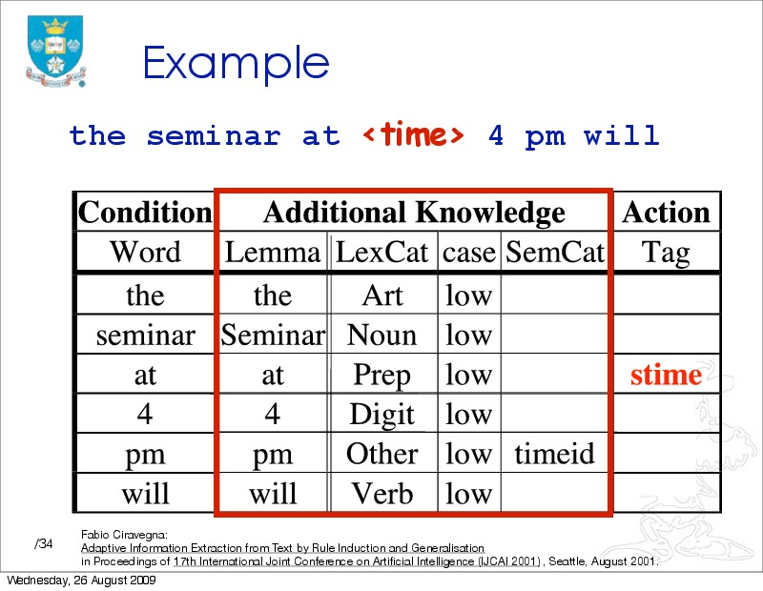

Slide 32
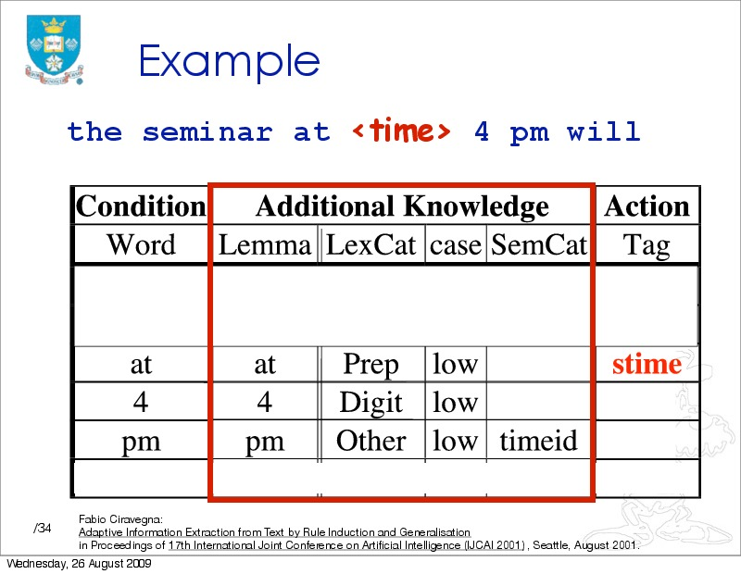

Slide 33
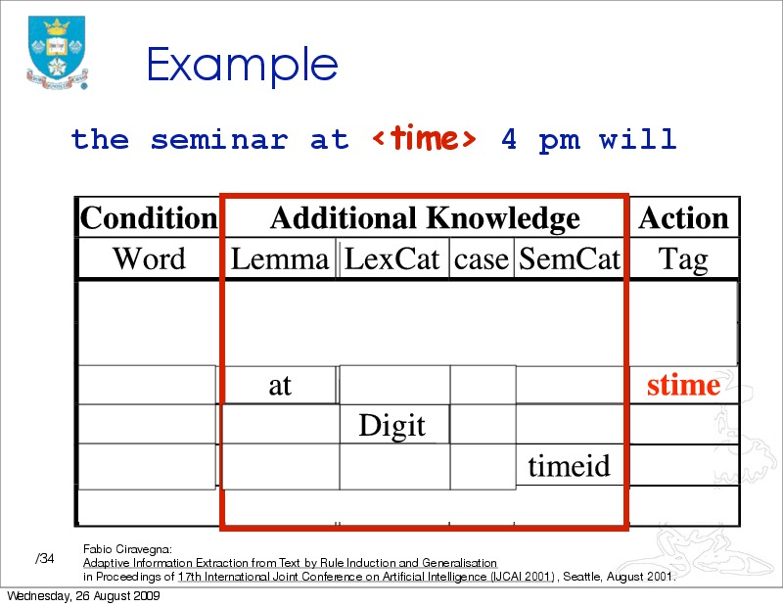

Slide 34
For each rule, we look for:
  Support (training examples that match this pattern)
  Conflicts (training examples that match this pattern with no annotation, or a different annotation)
Suppose we see:
"tomorrow at <stime>9 am</stime>"
  The rule in our example applies!
  If there are no conflicts, we have a more general rule
Overall: we try to take the most general rules which don't have conflicts

Slide 35
Returning to Evaluation
This time, evaluation specifically for IE

Slide 36
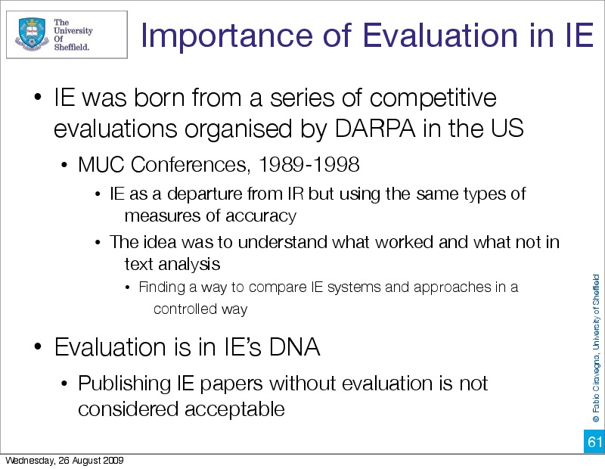

Slide 37
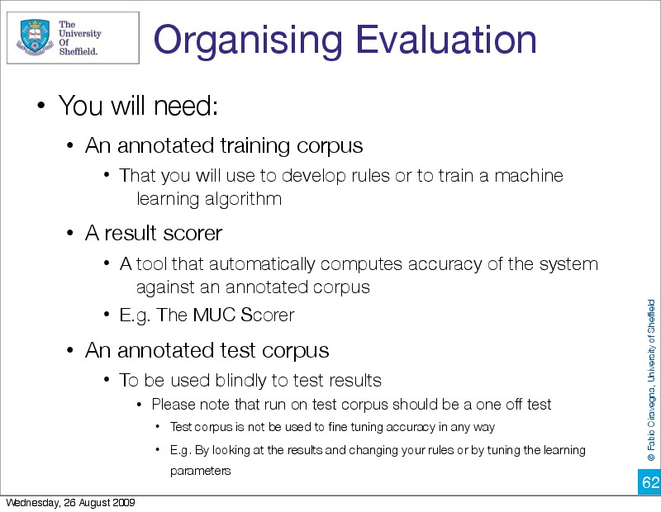

Slide 38
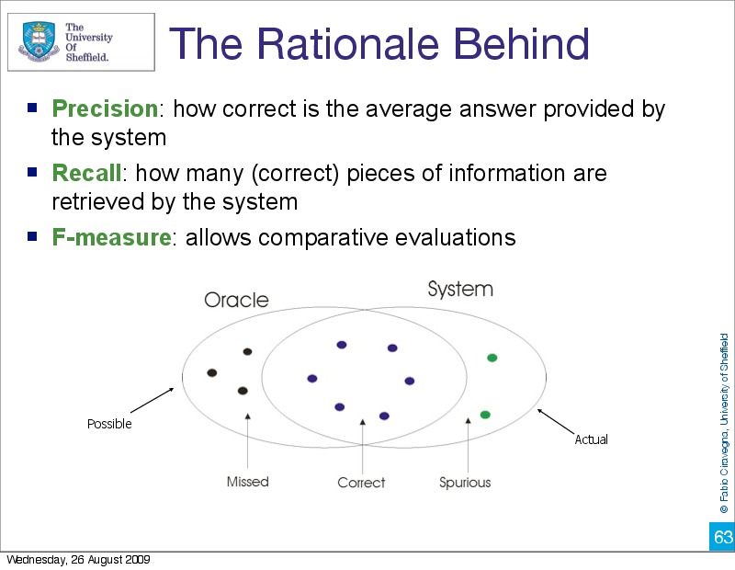

Slide 39
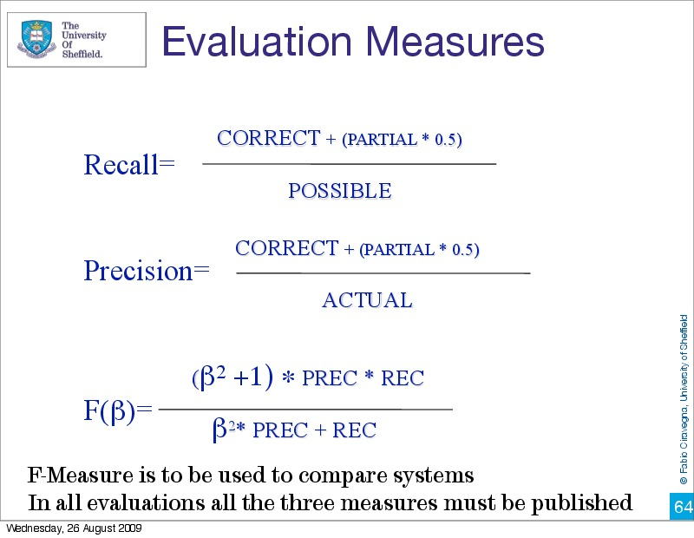

Slide 40
False Negative in CMU Seminars
Gold standard test set:
  Starting from <stime>11 am</stime>
System marks nothing:
  Starting from 11 am
False negative (which measure does this hurt?)

Slide 41
False Positive in CMU Seminars
Gold standard test set:
  ... Followed by lunch at 11:30 am , and meetings
System marks:
  ... at <stime>11:30 am</stime>
False positive (which measure does this hurt?)

Slide 42
Mislabeled in CMU Seminars
Gold standard test set:
  at a different time - <stime>6 pm</stime>
System marks:
  ... - <etime>6 pm</etime>
What sort of error do we have here?
Which measures are affected?
Note that this is different from Information Retrieval!

Slide 43
Partial Matches in CMU Seminars
Gold standard test set:
  ... at <stime>5 pm</stime>
System marks:
  ... at <stime>5</stime> pm
Then I get a partial match (worth 0.5)
Also different from Information Retrieval

Slide 44


Slide 45
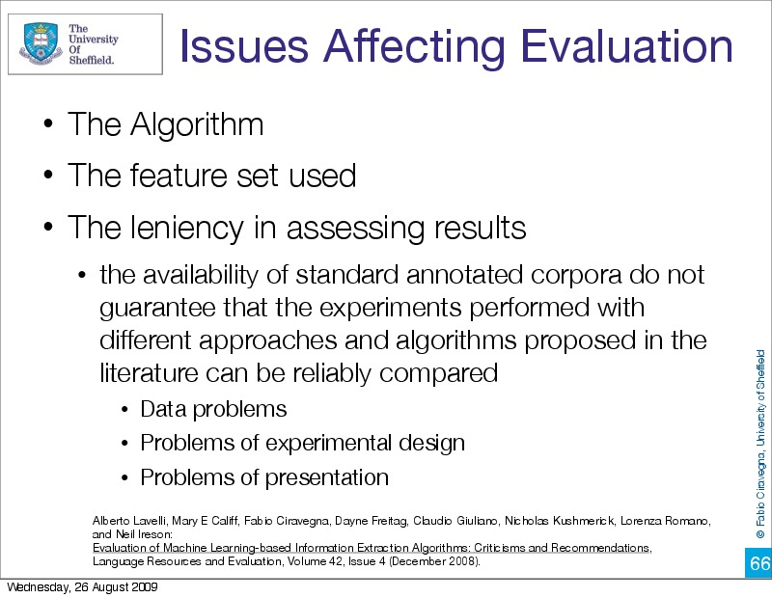

Slide 46
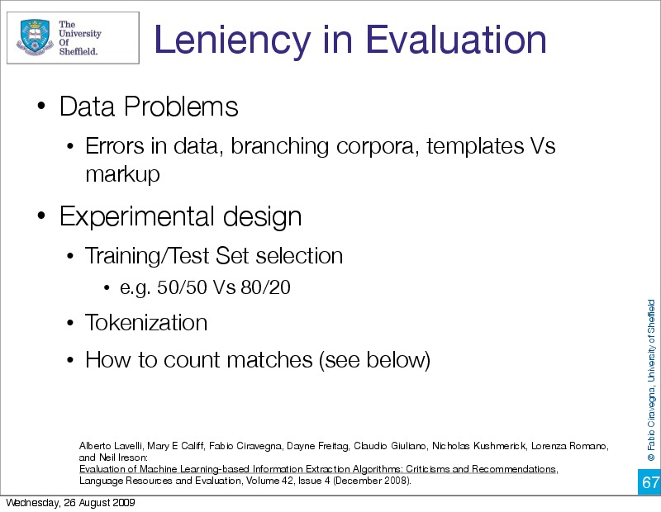

Slide 47
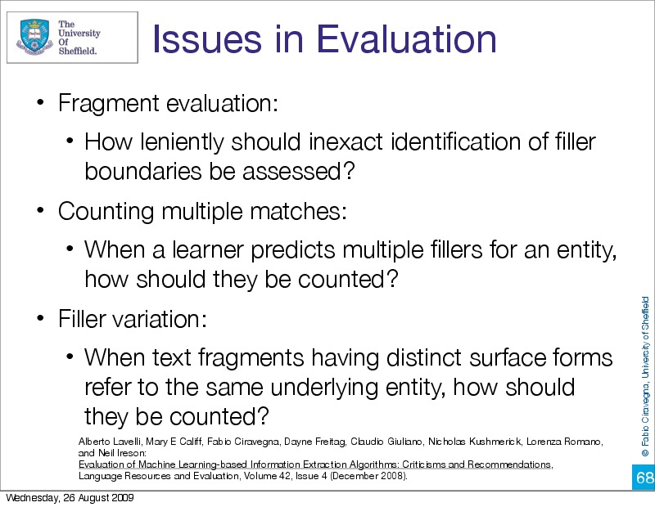

Slide 48
Evaluation is a critical issue where there is still much work to be done
But before we can evaluate, we need a gold standard
Training IE systems
  Critical component for "learning" statistical classifiers
  The more data, the better the classifier
Can also be used for developing a handcrafted NER system
  Constant rescoring and coverage checks are very helpful
Necessary in both cases for evaluation

Slide 49


Slide 50
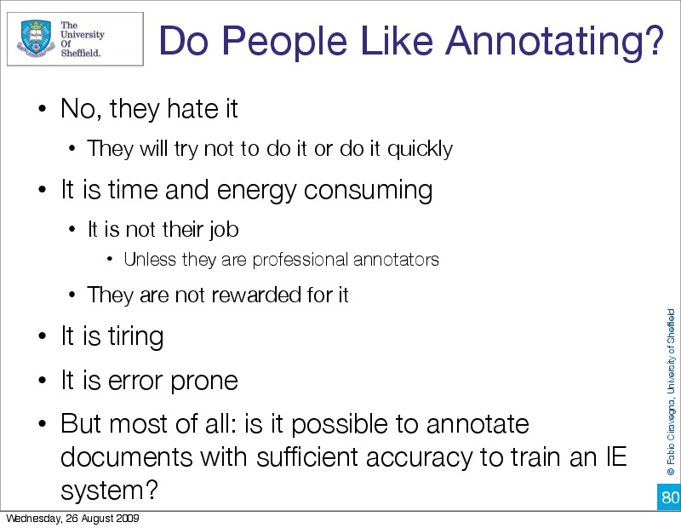

Slide 51


Slide 52
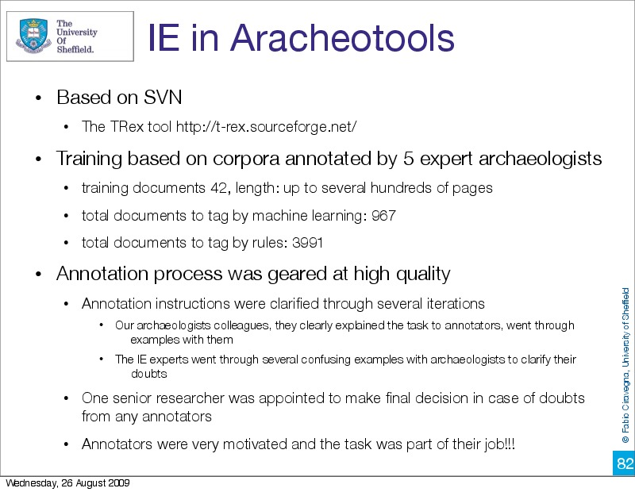

Slide 53
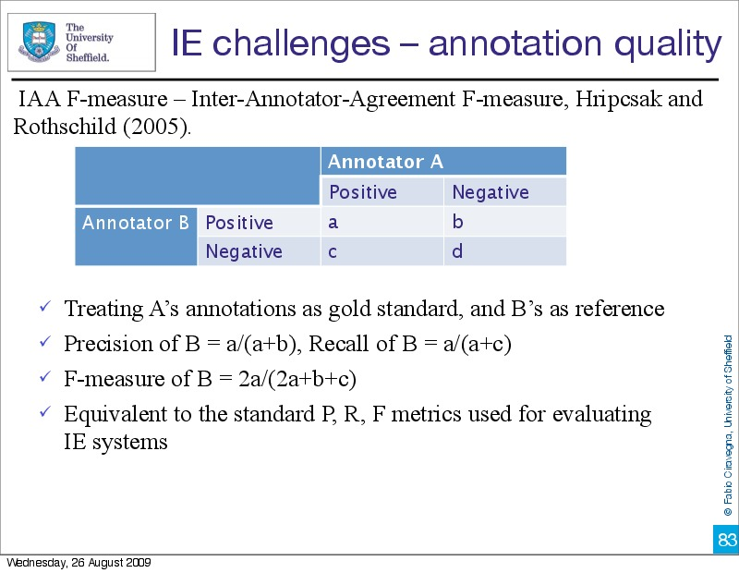

Slide 54
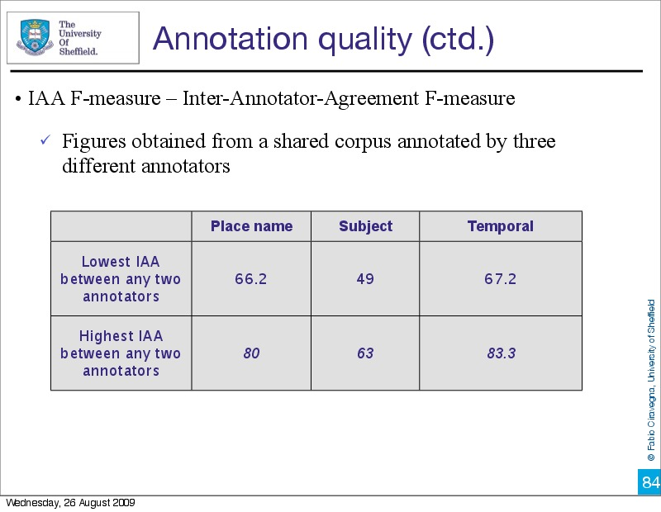

Slide 55
Annotator Variability
Differences in annotation are a significant problem
  Only some people are good at annotation
  Practice helps
Even good annotators can have different understanding of the task
  For instance, in doubt, annotate? Or not?
  (~ precision/recall tradeoffs)
Effect of using gold standard corpora that are not well annotated
  Evaluations can return inaccurate results
  Systems trained on inconsistent data can develop problems which are worse than if the training examples are eliminated
Crowd-sourcing, which we will talk about later, has all of these same problems even more strongly!

Slide 56
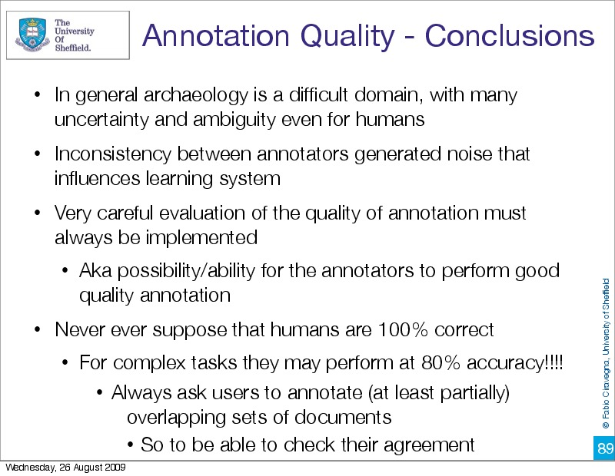

Slide 57
Slide sources
  Some of the slides presented today were from C. Lee Giles, Penn State and Fabio Ciravegna, Sheffield

Slide 58
Conclusion
Last two lectures
  Rule-based NER
  Learning rules for NER
  Evaluation
  Annotation
Please read Sarawagi Chapter 3!

Slide 59
Thank you for your attention!

