Slide 1
Information Extraction
CIS, LMU München
Winter Semester 2018-2019
Prof. Dr. Alexander Fraser, CIS

Slide 2
Information Extraction – Administravia - I
Vorlesung
Learn the basics of Information Extraction (IE)
Seminar
Each student will present a Referat on IE (Powerpoint, LaTeX, Mac)
The group will discuss it
Also: three or so practical sessions in the computer lab (hopefully we have time)
There are two seminars! You come to just one of the two sessions, either Wednesdays (Group 01) or Thursdays (Group 02)

Slide 3
Information Extraction – Administravia - II
Registration:
If you are a CIS Student: check whether you are registered for *both* the Vorlesung and the Seminar (these are two things in LSF!)
Please ignore the Modulteilprüfung entries, these will be deleted
There are a good number of people only in the Vorlesung
There are just a couple of people only in the Seminar

Slide 4
Information Extraction – Administravia - III
Vorlesung and Seminar are two separate courses (in same module for CIS people)
However, there may be some shifting around of slots depending on time constraints
Vorlesung (Grade):
Klausur (possibly last week of semester, no discussion of this today please)
Seminar (Grade):
Referat
Hausarbeit (write-up of the Referat) (6 pages, due 3 weeks after you hold your Referat)
The Hausarbeit can also include the practical exercises (optional, extra points)
CIS-ler: No Notenverbesserung (everyone else: ask in your Fachschaft!)

Slide 5
Information Extraction - Administravia - IV
First Seminar
I will collect information on who you are and your interests
And I want to know what you want to learn in this class!

Slide 6
Information Extraction – Administravia - V
Syllabus: updated dynamically on my web page (see also WS last year, but there will be some differences)
Brief idea at end of this slide deck (if we finish, then today)
List of Referatsthemen
This will be presented soon in the Seminar, next week
Literature:
Required: Sunita Sarawagi. Information Extraction. Foundations and Trends in Databases, 1(3):261–377, 2008. (good survey paper, somewhat brief)
Please read the introduction for next week (it is available on the web page!)
Optional: Christopher D. Manning, Prabhakar Raghavan and Hinrich Schuetze, Introduction to Information Retrieval, Cambridge University Press. 2008. (good information retrieval textbook, preview copies available from the book website: http://nlp.stanford.edu/IR-book/)

Slide 7
Information Extraction - Administravia - VI
There will also be guest lectures from Viktor Hangya, Dr. Matthias Huck, Dario Stojanovski
Our tutor, Tobias Eder, will help with the exercises and be available to help you with any questions

Slide 8
Questions?

Slide 9
Information Extraction
An introduction to the course
The topic "Information Extraction" means different things to different people
In this course we will look at several different perspectives
There is unfortunately no comprehensive textbook that includes all of these perspectives

Slide 10
My Biases
As you may have noticed by now: I am from the US (PhD in Computer Science from USC/ISI, Artifical Intelligence division)
I am a professor here at CIS
I do research in the broad area of statistical NLP
I mostly work on machine translation, and related structured prediction problems (e.g., treebank-based syntactic parsing, generation using sequence (tagging) models)
I also work on other multilingual problems such as cross-language information retrieval
With respect to rule-based NLP (with manually written rules), I'll try to be as fair as humanly possible, I do use these techniques sometimes too

Slide 11
Outline for today
Motivation
Problems requiring information extraction
Basic idea of the output
Abstract idea of the core of an information extraction pipeline
Course topics

Slide 12
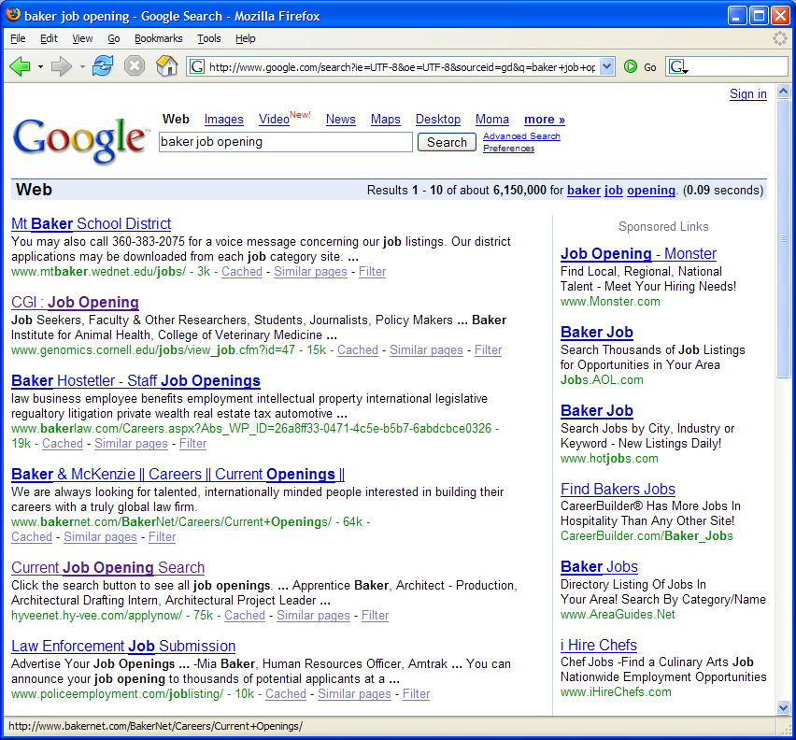
A problem
Mt. Baker, the school district
Baker Hostetler, the company
Baker, a job opening
Genomics job
Slide from Cohen/Mccallum

Slide 13
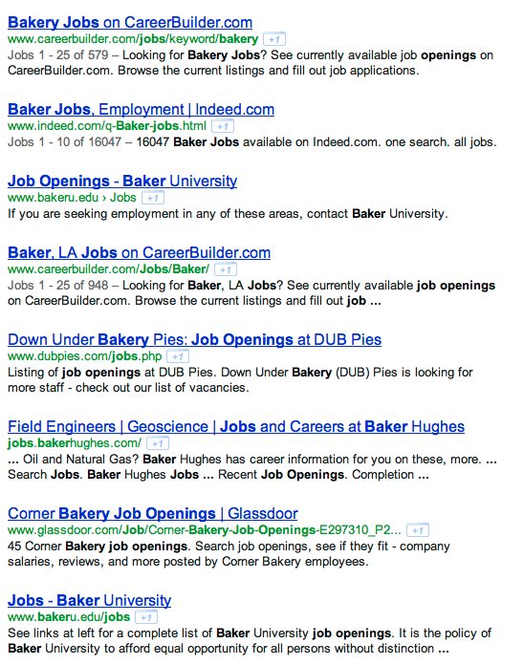
Slide from Kauchak

Slide 14
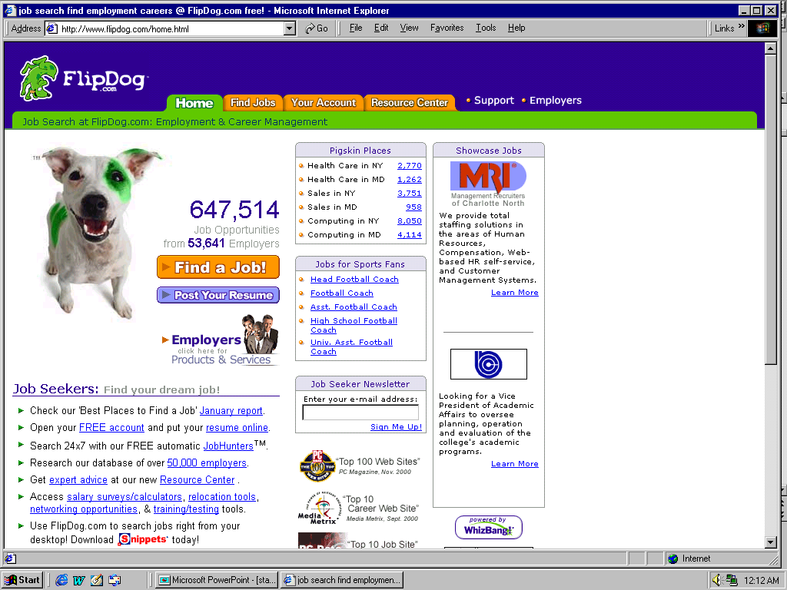
A solution
Slide from Cohen/McCallum

Slide 15
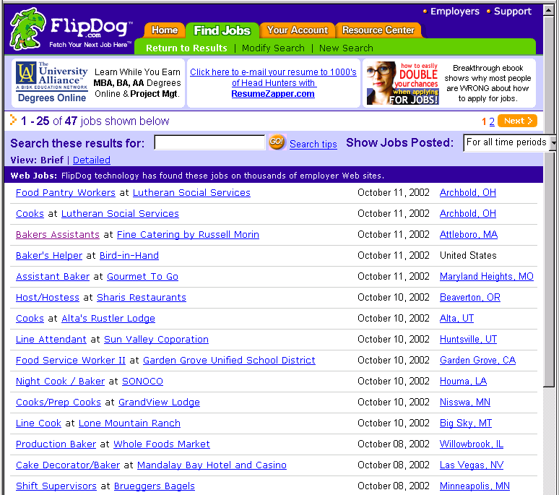
Job Openings:
Category = Food Services
Keyword = Baker
Location = Continental U.S.
Slide from Cohen/McCallum

Slide 16
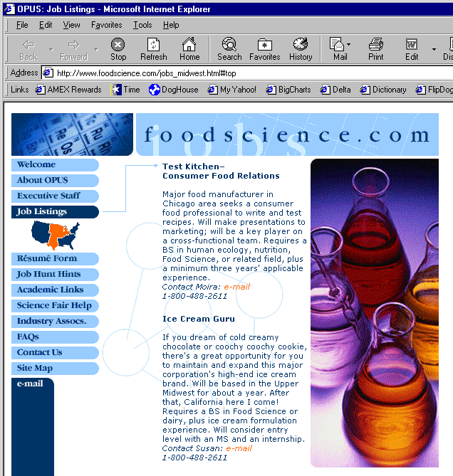
Extracting Job Openings from the Web
Title: Ice Cream Guru
Description: If you dream of cold creamy…
Contact: susan@foodscience.com
Category: Travel/Hospitality
Function: Food Services
Slide from Cohen/McCallum

Slide 17
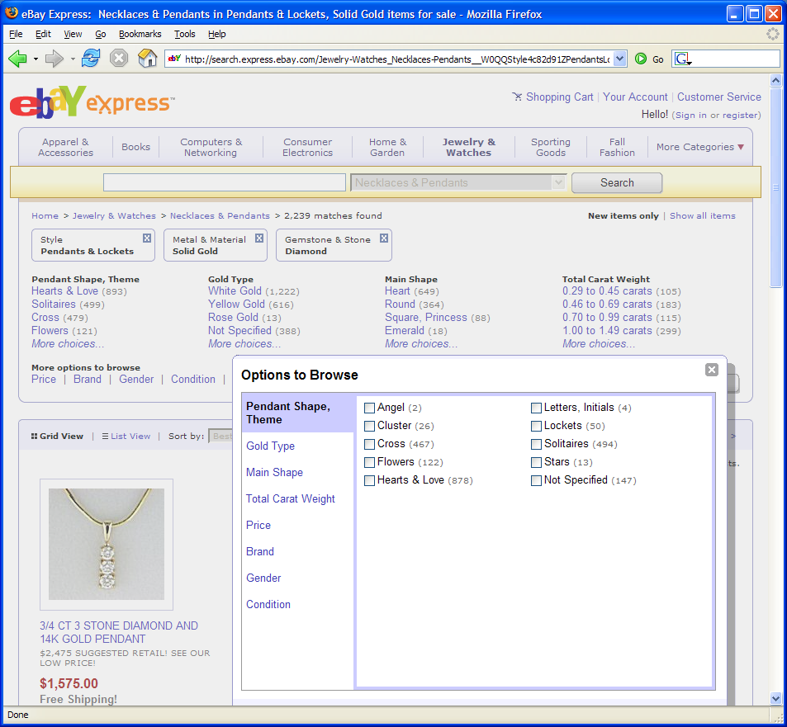
Another Problem
Slide from Cohen/McCallum

Slide 18
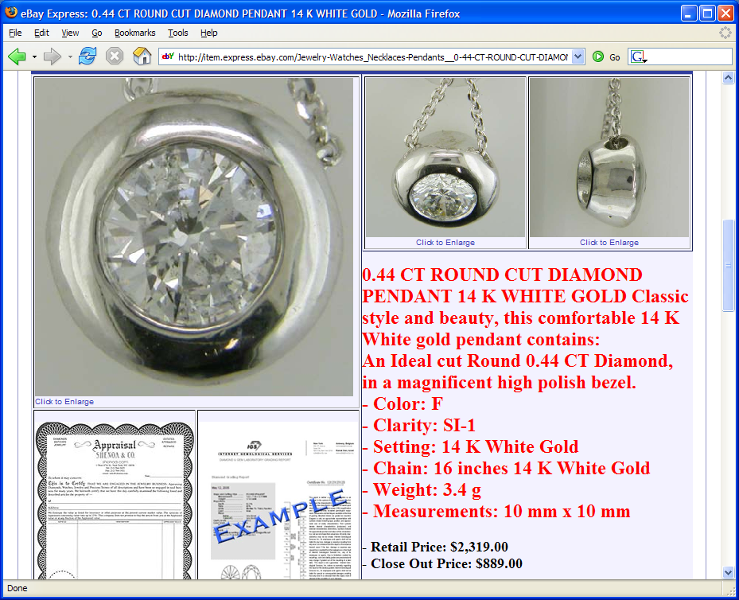
Often structured information in text
Slide from Cohen/McCallum

Slide 19
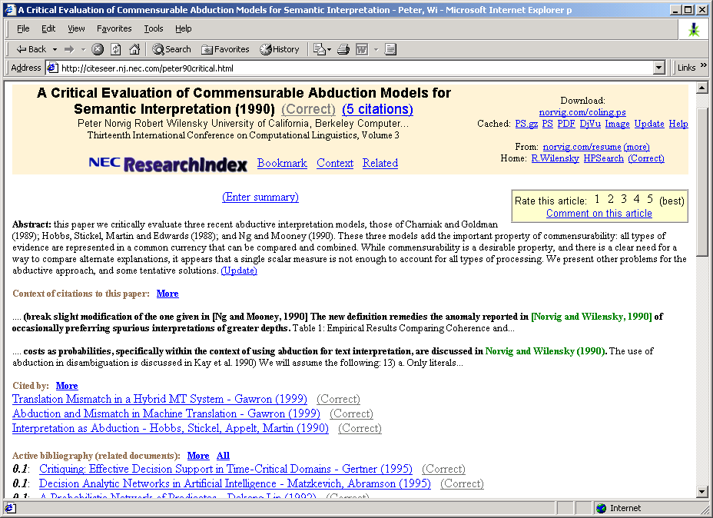
Another Problem
Slide from Cohen/McCallum

Slide 20
Definition of IE
Information Extraction (IE) is the process
of extracting structured information (e.g., database tables) from unstructured machine-readable documents
(e.g., Web documents).
Information
Extraction
GName | FName | Occupation
Elvis | Presley | singer
Elvis | Hunter | painter
... | ...
Elvis Presley was a famous rock singer.
...
Mary once remarked that the only attractive thing about the painter Elvis Hunter was his first name.
“Seeing the Web as a table”
Slide from Suchanek

Slide 21
Defining an IE problem
In what I will refer to as "classic" IE, we are converting documents to one or more table entries
There are other kinds of IE, we will talk about those later
The design of these tables is usually determined by some business need
Let's look at the table entries for a similar set of examples to the ones we just saw

Slide 22
Motivating Examples
Title | Type | Location
Business strategy Associate | Part time | Palo Alto, CA
Registered Nurse | Full time | Los Angeles
... | ...
Slide from Suchanek

Slide 23
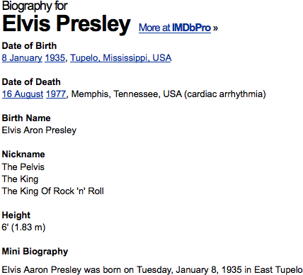
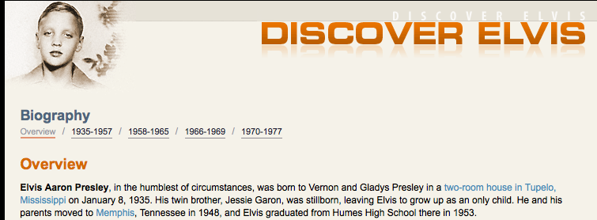
Motivating Examples
Name | Birthplace | Birthdate
Elvis Presley | Tupelo, MI | 1935-01-08
... | ...
Slide from Suchanek

Slide 24
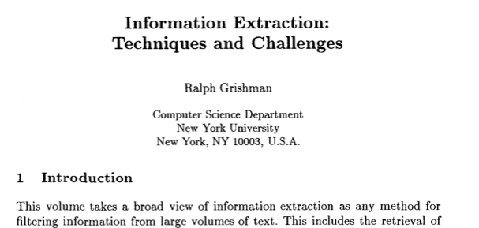
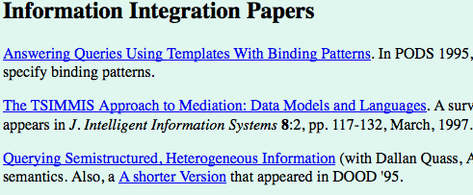
Motivating Examples
Author | Publication | Year
Grishman | Information Extraction... | 2006
... | ... | ...
Slide from Suchanek

Slide 25
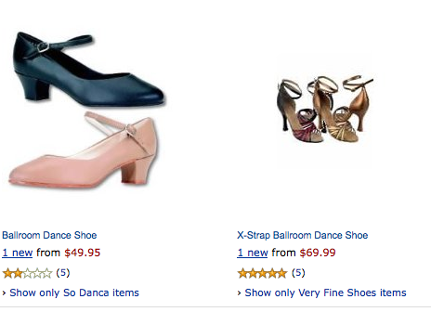
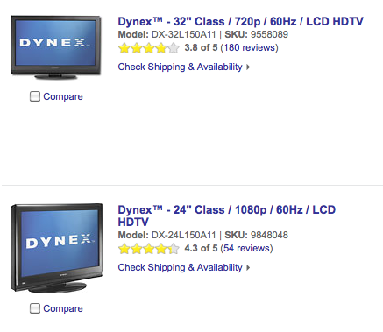
Motivating Examples
Product | Type | Price
Dynex 32” | LCD TV | $1000
... | ...
Slide from Suchanek

Slide 26
Information Extraction
Information Extraction (IE) is the process
of extracting structured information
from unstructured machine-readable documents
Source
Selection
?
Instance
Extraction
Person Name | Person Type
Elvis Presley | musician
Angela Merkel | politician
05/01/67
→
1967-05-01
Tokenization&
Normalization
Fact
Extraction
Relation | Entity1 | Entity2
Married | Elvis Presley | Priscilla Beaulieu
CEO | Tim Cook | Apple
Named Entity
Recognition
... married Elvis
on 1967-05-01
And Beyond!
Ontological
Information Extraction
Tip of the hat: Suchanek

Slide 27
Information Extraction
Traditional definition: Recovering structured data from text
What are some of the sub-problems/challenges?
Slide from Nigam/Cohen/McCallum

Slide 28
Information Extraction?
Recovering structured data from text
Identifying fields (e.g. named entity recognition)
Slide from Nigam/Cohen/McCallum

Slide 29
Information Extraction?
Recovering structured data from text
Identifying fields (e.g. named entity recognition)
Understanding relations between fields (e.g. record association)
Slide from Nigam/Cohen/McCallum

Slide 30
Information Extraction?
Recovering structured data from text
Identifying fields (e.g. named entity recognition)
Understanding relations between fields (e.g. record association)
Normalization and deduplication
Slide from Nigam/Cohen/McCallum

Slide 31
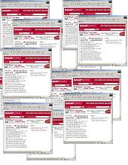
Information extraction
Input: Text Document
Various sources: web, e-mail, journals, …
Output: Relevant fragments of text and relations possibly to be processed later in some automated way
IE
User Queries
Slide from McCallum

Slide 32
Not all documents are created equal…
Varying regularity in document collections
Natural or unstructured
Little obvious structural information
Partially structured
Contain some canonical formatting
Highly structured
Often, automatically generated
Slide from McCallum

Slide 33
Natural Text: MEDLINE Journal Abstracts
Extract number of subjects, type of study, conditions, etc.
BACKGROUND: The most challenging aspect of revision hip surgery is the management of bone loss. A reliable and valid measure of bone loss is important since it will aid in future studies of hip revisions and in preoperative planning. We developed a measure of femoral and acetabular bone loss associated with failed total hip arthroplasty. The purpose of the present study was to measure the reliability and the intraoperative validity of this measure and to determine how it may be useful in preoperative planning. METHODS: From July 1997 to December 1998, forty-five consecutive patients with a failed hip prosthesis in need of revision surgery were prospectively followed. Three general orthopaedic surgeons were taught the radiographic classification system, and two of them classified standardized preoperative anteroposterior and lateral hip radiographs with use of the system. Interobserver testing was carried out in a blinded fashion. These results were then compared with the intraoperative findings of the third surgeon, who was blinded to the preoperative ratings. Kappa statistics (unweighted and weighted) were used to assess correlation. Interobserver reliability was assessed by examining the agreement between the two preoperative raters. Prognostic validity was assessed by examining the agreement between the assessment by either Rater 1 or Rater 2 and the intraoperative assessment (reference standard). RESULTS: With regard to the assessments of both the femur and the acetabulum, there was significant agreement (p < 0.0001) between the preoperative raters (reliability), with weighted kappa values of >0.75. There was also significant agreement (p < 0.0001) between each rater's assessment and the intraoperative assessment (validity) of both the femur and the acetabulum, with weighted kappa values of >0.75. CONCLUSIONS: With use of the newly developed classification system, preoperative radiographs are reliable and valid for assessment of the severity of bone loss that will be found intraoperatively.
Slide from Kauchak

Slide 34
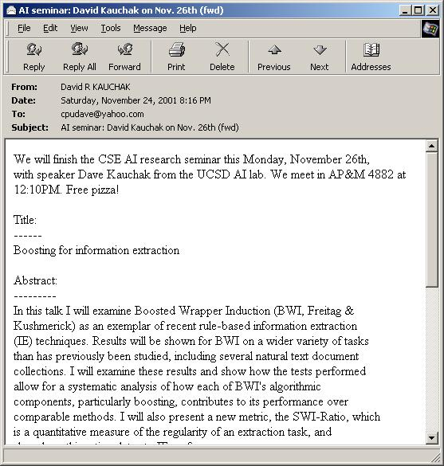
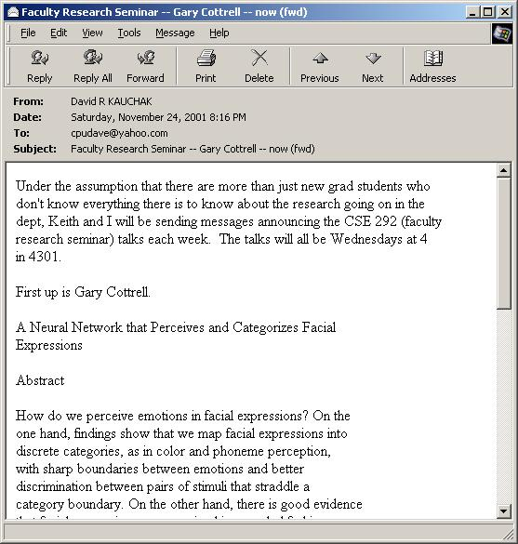
Partially Structured: Seminar Announcements
Extract time, location, speaker, etc.
Slide from Kauchak

Slide 35
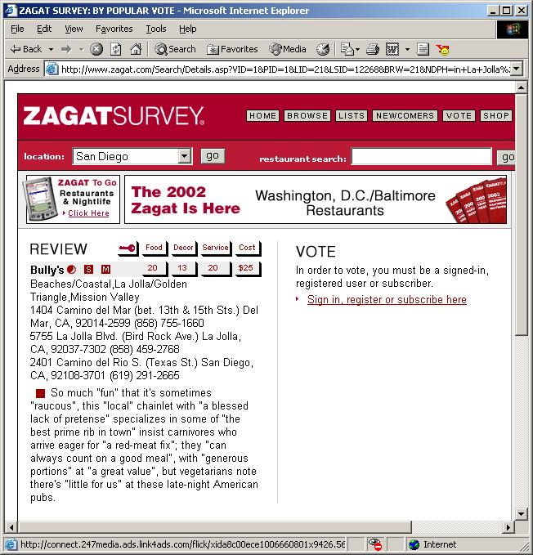
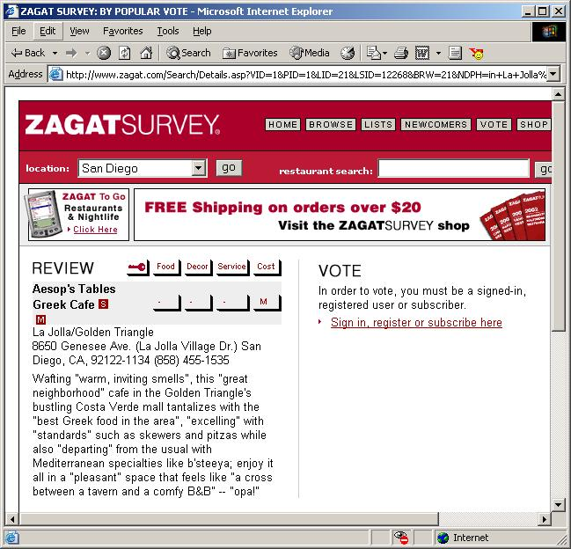
Highly Structured: Zagat’s Reviews
Extract restaurant, location, cost, etc.
Slide from Kauchak

Slide 36
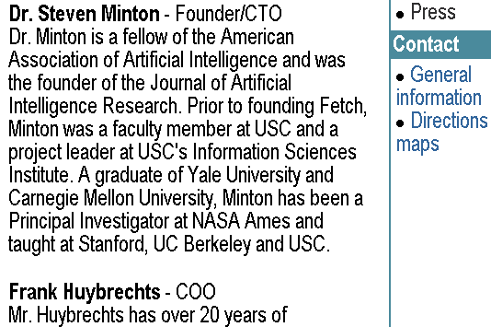
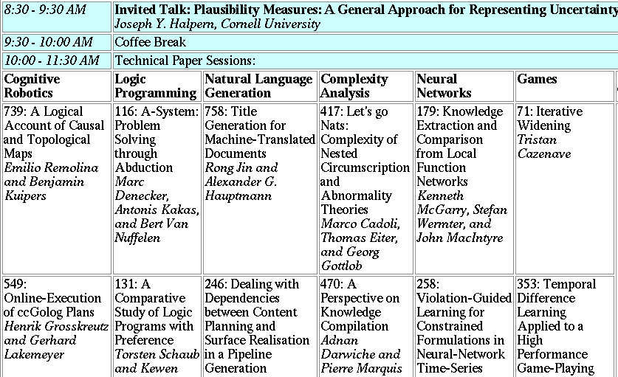
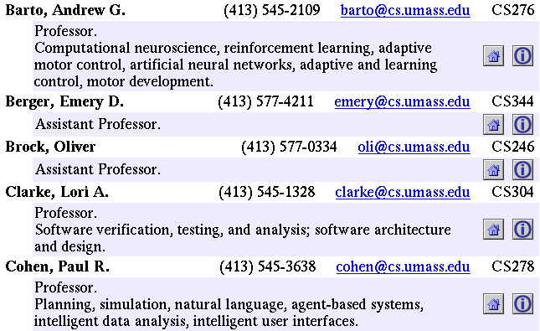
Landscape of IE Tasks: Document Formatting
Text paragraphs
without formatting
Grammatical sentences and some formatting & links
Astro Teller is the CEO and co-founder of BodyMedia. Astro holds a Ph.D. in Artificial Intelligence from Carnegie Mellon University, where he was inducted as a national Hertz fellow. His M.S. in symbolic and heuristic computation and B.S. in computer science are from Stanford University.
Tables
Non-grammatical snippets, rich formatting & links
Slide from McCallum

Slide 37
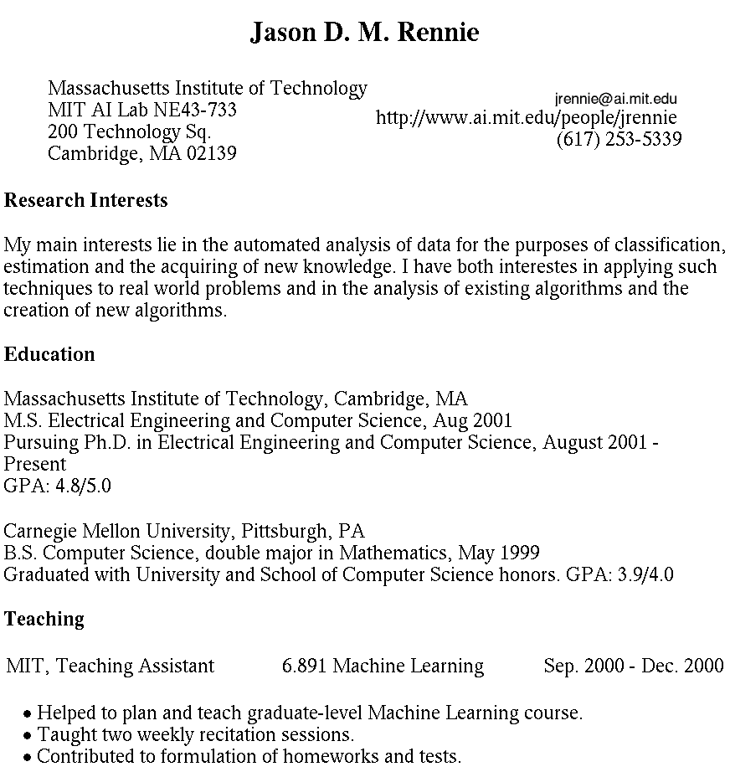
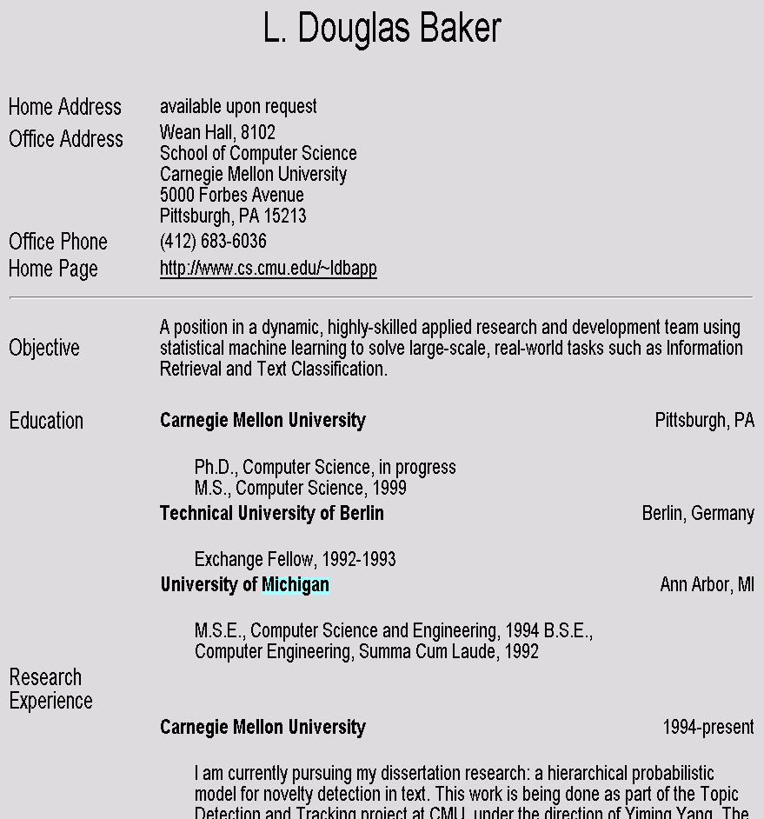
Landscape of IE Tasks Intended Breadth of Coverage
Web site specific
Genre specific
Wide, non-specific
Formatting
Layout
Language
Amazon.com Book Pages
Resumes
University Names
Slide from McCallum

Slide 38
Landscape of IE Tasks : Complexity of entities/relations
Closed set
Regular set
U.S. states
U.S. phone numbers
He was born in Alabama…
Phone: (413) 545-1323
The big Wyoming sky…
The CALD main office is 412-268-1299
Ambiguous patterns, needing context and many sources of evidence
Complex pattern
U.S. postal addresses
Person names
University of Arkansas
P.O. Box 140
Hope, AR 71802
…was among the six houses sold by Hope Feldman that year.
Headquarters:
1128 Main Street, 4th Floor
Cincinnati, Ohio 45210
Pawel Opalinski, Software Engineer at WhizBang Labs.
Slide from McCallum

Slide 39
Landscape of IE Tasks: Arity of relation
Jack Welch will retire as CEO of General Electric tomorrow. The top role at the Connecticut company will be filled by Jeffrey Immelt.
Single entity
Binary relationship
N-ary record
Person: Jack Welch
Relation: Person-Title
Person: Jack Welch
Title: CEO
Relation: Succession
Company: General Electric
Title: CEO
Out: Jack Welsh
In: Jeffrey Immelt
Person: Jeffrey Immelt
Location: Connecticut
Relation: Company-Location
Company: General Electric
Location: Connecticut
"Named entity" extraction
Slide from McCallum

Slide 40
Association task = Relation Extraction
Checking if groupings of entities are instances of a relation
Manually engineered rules
Rules defined over words/entities: “<company> located in <location>”
Rules defined over parsed text:
“((Subj<company>) (Verb located) (*) (Obj <location>))”
Machine Learning-based
Supervised: Learn relation classifier from examples
Partially-supervised: bootstrap rules/patterns from “seed” examples
Slide modified from Manning

Slide 41
Relation Extraction: Disease Outbreaks
May 19 1995, Atlanta -- The Centers for Disease Control and Prevention, which is in the front line of the world's response to the deadly Ebola epidemic in Zaire , is finding itself hard pressed to cope with the crisis…
Date | Disease Name | Location
Jan. 1995 | Malaria | Ethiopia
July 1995 | Mad Cow Disease | U.K.
Feb. 1995 | Pneumonia | U.S.
May 1995 | Ebola | Zaire
Information Extraction System
Slide from Manning

Slide 42
Relation Extraction: Protein Interactions
“We show that CBF-A and CBF-C interact
with each other to form a CBF-A-CBF-C complex
and that CBF-B does not interact with CBF-A or
CBF-C individually but that it associates with the
CBF-A-CBF-C complex.“
interact
complex
CBF-A CBF-C
CBF-B CBF-A-CBF-C complex
associates
Slide from Manning

Slide 43
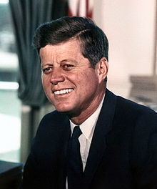
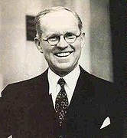
Resolving coreference (both within and across documents)
John Fitzgerald Kennedy was born at 83 Beals Street in Brookline, Massachusetts on Tuesday, May 29, 1917, at 3:00 pm,[7] the second son of Joseph P. Kennedy, Sr., and Rose Fitzgerald; Rose, in turn, was the eldest child of John "Honey Fitz" Fitzgerald, a prominent Boston political figure who was the city's mayor and a three-term member of Congress. Kennedy lived in Brookline for ten years and attended Edward Devotion School, Noble and Greenough Lower School, and the Dexter School, through 4th grade. In 1927, the family moved to 5040 Independence Avenue in Riverdale, Bronx, New York City; two years later, they moved to 294 Pondfield Road in Bronxville, New York, where Kennedy was a member of Scout Troop 2 (and was the first Boy Scout to become President).[8] Kennedy spent summers with his family at their home in Hyannisport, Massachusetts, and Christmas and Easter holidays with his family at their winter home in Palm Beach, Florida. For the 5th through 7th grade, Kennedy attended Riverdale Country School, a private school for boys. For 8th grade in September 1930, the 13-year old Kennedy attended Canterbury School in New Milford, Connecticut.
Slide from Manning

Slide 44
Rough Accuracy of Information Extraction
Information type | Accuracy
Entities | 90-98%
Attributes | 80%
Relations | 60-70%
Events | 50-60%
Errors cascade (error in entity tag → error in relation extraction)
These are very rough, actually optimistic, numbers
Hold for well-established tasks, but lower for many specific/novel IE tasks
Slide from Manning

Slide 45
What we will cover in this class (briefly)
PART I: basic information extraction (through Named Entity Recognition)
History of IE, Related Fields
Source Selection
Tokenization and Normalization
Named Entity Recognition (NER)

Slide 46
What we will cover in this class (briefly)
PART II: machine learning in depth (mostly tagging models used for named entities)
Decision Trees and Overfitting
Linear Models
Feature Engineering
Word Embeddings
Deep Learning (Non-Linear Models)
In the seminar: the practical exercises will be on practical classification (you are also invited to these even if you are not in the seminar!)

Slide 47
What we will cover in this class (briefly)
PART III: advanced information extraction
Instance Extraction
Fact/Event Extraction
Ontological IE/Open IE
Sentiment Analysis

Slide 48
Seminar
Please attend the seminar tomorrow if you did not attend it today, will be about 20 minutes, I am collecting information that is very useful for planning
Also, don't forget the reading for next week!
Sarawagi: Information Extraction (available from web page). Read the introduction!

Slide 49
Thank you for your attention!

